Slide 1

Chinese and Italian Enterprises Association
CINITALY
中国和意大利的企业协会
the silk road 4.0
丝绸之路 4.0

Slide 2
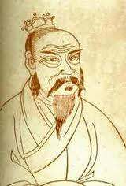

A new way to trade and cooperate, finding the positive points of two countries so far but with many values in common.
The culture first of all: Italy and China are quite different, but share a millenary civilization, the value of family, work and friendship, for example.
Businesses, professionals, institutions, associated with CINITALY, share the values of respect for commitments and people and of transparency in trade relations.
The associates who respect these basic rules, but important, will have no distinction of the nation they belong to.
贸易和合作，共同寻找积极的点，但很多值的两个国家到目前为止新方法。
文化首先︰ 意大利和中国有很大不同，但共享千年的文明、 价值的家庭、 工作和友谊，例如。
企业，专业人士、 机构，与 CINITALY，分享价值承诺和人们的尊重和贸易关系的透明度。
同伙人尊重这些基本的规则，但重要的是，会有他们属于国家没有区别。

Slide 3
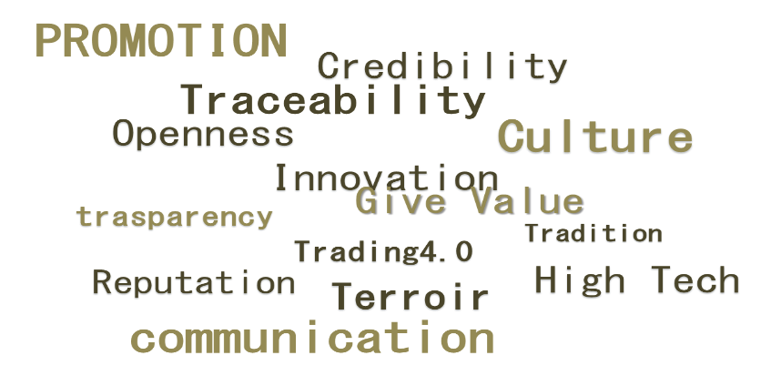





SISTEMA INDUSTRIA Italia

Slide 4
PORTAL
Instrument of encounter between Chinese and Italian companies to realize a dynamic matching between business opportunities in bi-directional mode
www.cinitaly.it
www.cinitaly.cn
www.cinitaly.com
TARGETS
become the Chinese and Italian reference point for b2b activities
create a culture of internationalization in both Countries
generate content useful to businesses, through handouts vertical issues
aggregate operators, professionals and experts to create a "chain of business" Sino-Italian

Slide 5
the founding companies
Zhongkexuedao
The School of Science and Innovation in China/ Vision Think Tank / T5 Union
Beijing Zhongkexuedao Technology Co., Ltd is a hunting platform in China targeting high-end technological talents which helps the tech personnel with exchanges of ideas and upholds partnership learning when building social platform.
Beijing Zhongkexuedao Technology Co., Ltd - www.cashr.cn
N° 89 ZhongGuanCun East Road, Haidian District, Beijing 100190
China
Tel. +86 10 625 35525
Ref.: Joseph Li – liyue_ad@163.com

Slide 6
the founding companies
IE Consulting
give values to Italian Excellence
In this era of global competition, the future of many organizations, depends on the success of the projects set up to respond adequately to the challenges that such competition requires us. Right skills and new tools allow you to turn the threat into an opportunity.
The global social and economic models are increasingly based on the sharing of wealth, participation and attention to the environment and society; in the future, companies can build their reputation in the market, only if they are able to listen to their "stakeholders" and build lasting relationships of trust with them over time.
Regarding the internationalization, the winning model is the collaboration and the sharing of common objectives among participants, although with different culture and vision of the business, namely: create a network. This new "knowledge" economy requires a new ability to read and open business models that enhance each entity in the chain: communities, customers, suppliers and employees are an integral part of the company system.
IE Consulting srl - www.ieconsultingsrl.com
Via Atlantici, n.4 – 82100 Benevento (BN)
Italy
Tel. +39 0824 315248
Ref.: Mirko DI Rubbo – mirko.dirubbo@ieconsultingsrl.com

Slide 7
the founding companies
Finitaly & Partners
Innovative Consulting Service means cover the entire process of operations and develops a close relationship, with private and institutional clients
An Italian company of strategic and financial consultancy based in Rome and that has its own international network, focuses its activities in the areas of corporate finance with particular expertise in the “public funds” at Community, national and regional level (“public funds” mean current operating funds, special funds, interest and sinking funds ).
Finitaly & partners srl - www.finitay.it
Piazza Euclide, n.47 – 00197 Rome
Italy
Tel. +39 06 8080157
Ref.: Arrigo Montella – a.montella@finitaly.it

Slide 8
the founding companies
SI Italia
enjoyment of excellence
Create a wide range of services that can support the needs of small and micro enterprises in Italy on their way towards internationalisation. State-of-the-art techniques and technologies, such as InfoSeal®, to help and support companies in networking, shared with many amenities offered.
SI Italia srl - www.siitaliasrl.it
Via Nizza, n.4 – 00187 Rome
Italy
Tel. +39 0774 605015
Ref.: Valeria Minafra – valeria.minafra@siitaliasrl.it

Slide 9
the founding companies
SISTEMA INDUSTRIA Italia
Sistema Industria Italia
organize and orient our member companies in order to promote its development,
work for the appreciation of italian style and made in Italy
Sistema Industria is a network of companies organized at the regional level, with the task of providing services to its members (from administrative and legal support to job counseling, by subsidized loans internationalization). This last activity is engaged in representation abroad actions of its members, in perticolare for SMEs. (more info: www.sistemaindustria.com).
Sistema Industria Italia - www.sistemaindustria.com
Via Livio Agresti 12, 00147 , Roma
Italy
Tel. +39 0774 605015
Ref.: Alessandra Bianchi – b.arch.alex@tiscali.it

Slide 10
CINITALY - Business sector/ skill
Food & Beverage
Fashion
Furniture
Hi Tech
  Smart City
  Smart Farming
  Environment
  ICT (Healthcare, Prevention Dep., Food traceability, Tourism,…)
  New Materials
  Avionics
  Architecture and design
Pharmaceutic
Cosmeceutics
Value added services
  System Integration
  Design
  DLS – Distance Learning System

Slide 11

CINITALY’s instruments
Multisectorial Technical Commitee
EcoBusiness Portal
UCIST – China Italy Science & Technology Union
Italian Experience
In order to support more effectiveness and concreteness our way of Italian and Chinese businesses in their pursuit of creating partnership, a Multi-sectoral Technical Committee (MTC) exists.
MTC professionals who, thanks to their long experience in different technologies, products sectors and services, can help you in finding the best answer to every needs that they should ripen within the Association.
MTC will consider requests coming from Italy and China, all in order to bring together supply and demand.
MTC will be the “subject” who will interface Institutional bodies that are operating in Scientific Research, University or Institutions: UCIST – China Italy Science & Technologic Union.
At the date the MTC’s interesting sectors consists in:
INDUSTRIAL EQUIPMENT – FOOD PROCESSING
AVIONIC & AEROSPACE
SMART FARMING/ SMART CITIES (SYSTEM INTEGRATION)
SENSORS/ ATTUATORS/ IoT
ENVIRONMENT SAVING
TRACEABILITY & TRACKING
PHARMACEUTICAL/ COSMECEUTICS
SCIENCE OF MATERIALS/ MECHANICAL & STRUCTURAL/ DESIGN
ARCHICTETURE/ INTERNAL DESIGN.

Slide 12

CINITALY’s instruments
Multisectorial Technical Commitee
EcoBusiness Portal
UCIST – China Italy Science & Technology Union
Italian Experience
Sections:
Micro thematic blogs (finance, Customs, Legal, Marketing, career, ...)
Exchange area:
  requests from Italy
  requests from China
Articles (scientifics content; General knowledge, Current events, ..)
Handouts
Events
Contacts
Social network (link to FB, LinkedIn, Wechat,…)
Videos. It’s a section devoted to collecting videos/multimedia content. The main goal is to represent in 90-120 seconds the professionalism and the production of the enterprise itself. In China it is a method of the most used and appreciated to present a company to potential market interested in his skills
CONTENTS CONTRIBUTORS
All “core” partners
Scientific/R&D Institutions, Universities
Associates (with their own skills)
Others (Bank of China; Radio China International; Italian Confucio Institute; …)
will be published editorials and articles at a rate of three to four per week(multi media contents).
Languages:
English
Chinese
Italian.

Slide 13

CINITALY’s instruments
Multisectorial Technical Commitee
EcoBusiness Portal
UCIST – China Italy Science & Technology Union
Italian Experience
Education, Comunication, Cultural Training, Technology transfer and cooperation are the key words to explain the roles and mission of this “Think Tank”.
UCIST wants to be, for the institutional organizations, a reference point in order to support Chinese and Italian companies in their effort to innovation and the use of high technology.
The MTC will Cinitaly operating tool in relating with UCIST, thus putting in contact the needs and possible solutions.
List of institutional bodies (potential, that Cinitaly propose to partnership):
[Italy, Trieste] International Foundation of Trieste - FIT
[Italy, Rome] National Council of Research – CNR (Labs)
[Italy, Rome] Italian National Agency for New Technologies, Energy and Sustainable Economic Development – ENEA (Labs)
[Italy, Trento] E. Mach Foundation - IASMA
[China, Jinan] Shandong Association for Science & Technology – SDAST
[China, Zhengzhou] Henan 863 Software Incubator - 863 Soft
[China, Beijing] China International Technology Transfer Center – CITTC
[China, Hangzhou] Hangzhou High Technology Zone – HHTZ
….

